Slide 1
Chapter 10 Chemical Bonding II: Molecular Geometry and Hybridization of Atomic Orbitals
Dr. Sultana Bedoura

Slide 2
GEOMETRIES OF MOLECULES
All molecules containing three or more atoms are three-dimensional
The shape of a particular molecule is determined by the specific arrangement of atoms in it and the bond angles
Molecular shapes may be linear, bent (or angular), trigonal planar, pyramidal or tetrahedral
The shapes of molecules can be determined methods such as X-ray and electron diffraction techniques
Molecular shapes are important because
They are helpful in the investigation of molecular polarity, molecular symmetry or asymmetry.
Physical and chemical properties of compounds depend on these factors

Slide 3
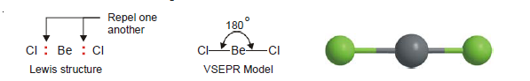
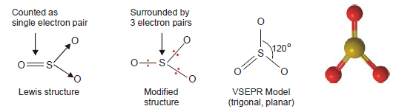
Examples
Linear Molecules: Beryllium chloride, BeCl₂
Trigonal Planar Molecules: Sulphur trioxide, SO₃

Slide 4
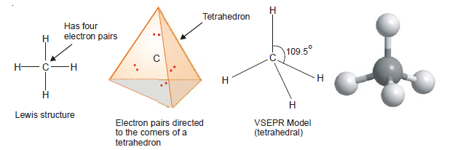
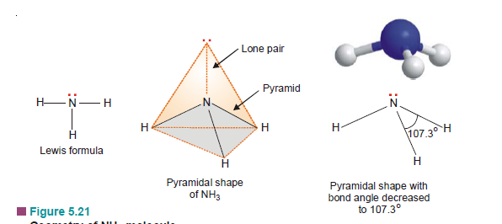
Examples
Tetrahedral Molecules: Methane, CH₄
Pyramidal Molecules: Ammonia molecule, NH₃

Slide 5
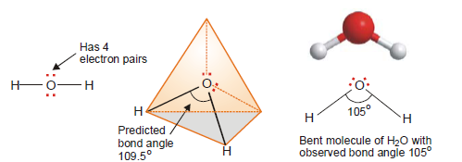
Example
Bent or Angular Molecules: Water, H₂O

Slide 6
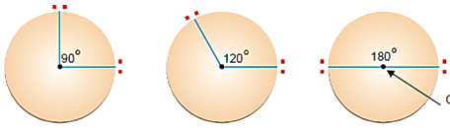
VSEPR THEORY
VSEPR theory is simple but remarkably powerful model for predicting molecular geometries and bond angles
R.G.Gillespie (1970) proposed a theory called the Valence-Shell Electron Pair Repulsion or VSEPR
It states that :
“The electron pairs (both lone pairs and shared pairs), surrounding the central atom will be arranged in space as far apart as possible to minimize the electrostatic repulsion between them”
Central atom

Slide 7
VSEPR THEORY
It must be remembered :
Multiple bonds behave as a single electron-pair bond for the purpose of VSEPR. They represent a single group of electrons.
Order of repulsions between lone pair &lone pair (lp-lp), lone pair & bonding pair (lp-bp), and bonding pair & bonding pair (bp-bp) is
When a molecule has lone pairs of electrons, the bonding electron pairs are pushed closer that decreases the bond angle
lp – lp > > lp – bp > bp – bp

Slide 8
VSEPR model
Two general rules:
As far as electron-pair repulsion is concerned, double bonds and triple bonds can be treated like single-bond
If a molecule has two or more resonance structures, we can apply the VSEPR model to any one of them. Formal charges are usually not shown.
We divide the molecules into two categories, according to whether or not the central atom has lone pair or not

Slide 9
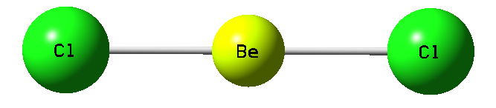
VSEPR model
Molecules in which the central atom has no lone pairs
Molecules containing only two elements, A and B
A is the central atom
General formula ABx, x is integer = 2, 3, ….
x = 2, diatomic molecule, AB₂
Example:
Class
# of atoms bonded to central atom
# lone pairs on central atom
Arrangement of electron pairs
Molecular
Geometry
AB₂
2
0
Cl
Be
Cl
2 atoms bonded to central atom

Slide 10
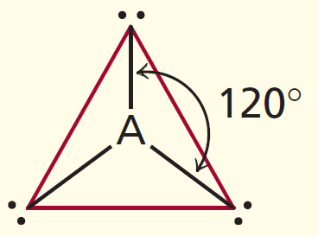
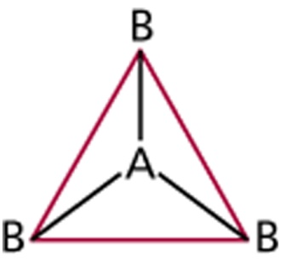
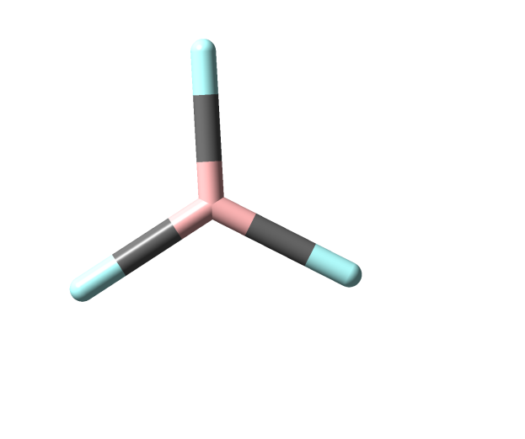
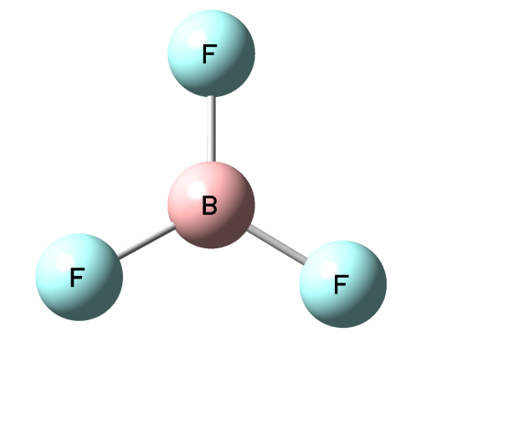
VSEPR model
x = 3, diatomic molecule, AB₃
Example:
Class
# of atoms bonded to central atom
# lone pairs on central atom
Arrangement of electron pairs
Molecular
Geometry
AB₂
2
0
linear
linear
AB₃
3
0
trigonal planar
trigonal planar
Planar

Slide 11
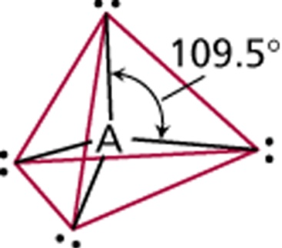
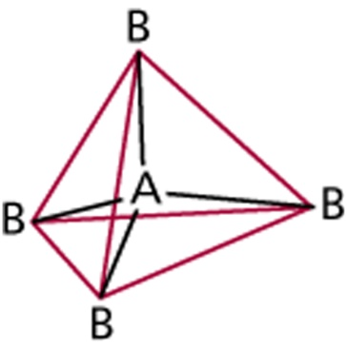
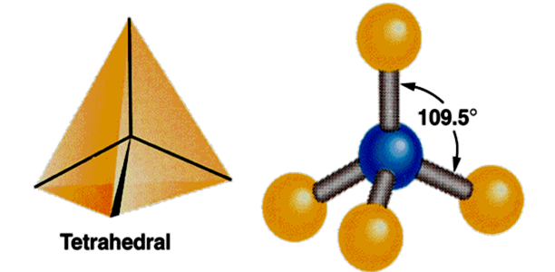
VSEPR model
Example:
Class
# of atoms bonded to central atom
# lone pairs on central atom
Arrangement of electron pairs
Molecular
Geometry
AB₂
2
0
linear
linear
AB₃
3
0
trigonal planar
trigonal planar
AB₄
4
0
tetrahedral
tetrahedral
H
C
H
H
H

Slide 12
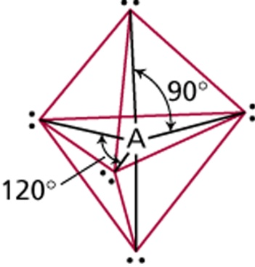
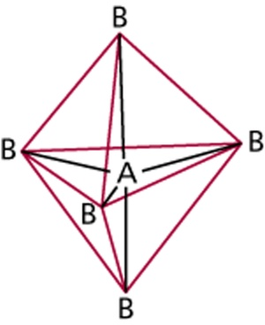
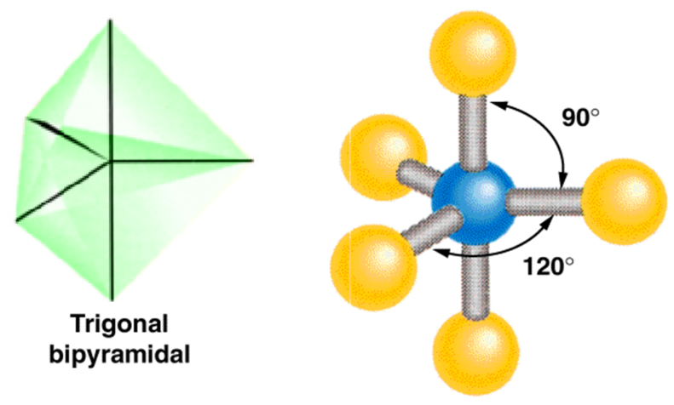
VSEPR model
Example:
Class
# of atoms bonded to central atom
# lone pairs on central atom
Arrangement of electron pairs
Molecular
Geometry
AB₂
2
0
linear
linear
AB₃
3
0
trigonal planar
trigonal planar
AB₄
4
0
tetrahedral
tetrahedral
trigonal
bipyramidal
trigonal
bipyramidal
AB₅
5
0
Cl
Cl
P
Cl
Cl
Cl

Slide 13
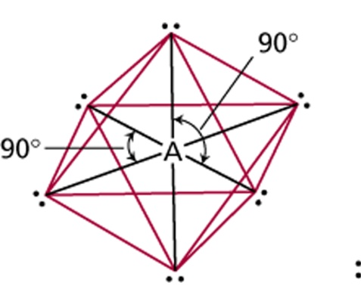
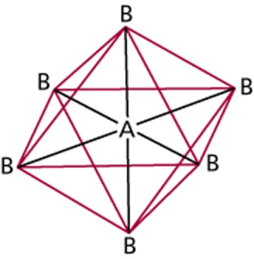
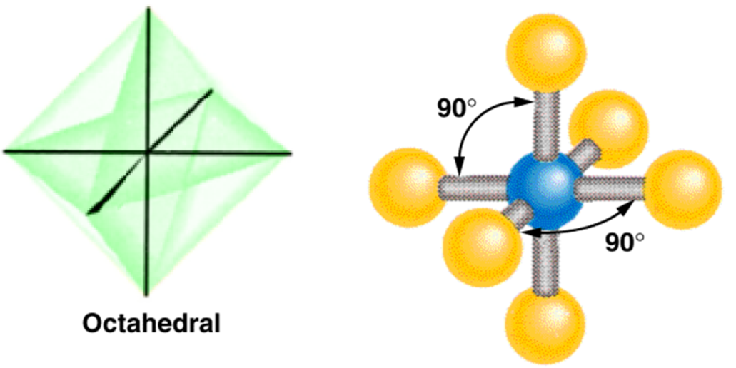
VSEPR model
Example:
Class
# of atoms bonded to central atom
# lone pairs on central atom
Arrangement of electron pairs
Molecular
Geometry
AB₂
2
0
linear
linear
AB₃
3
0
trigonal planar
trigonal planar
AB₄
4
0
tetrahedral
tetrahedral
trigonal
bipyramidal
trigonal
bipyramidal
AB₅
5
0
AB₆
6
0
octahedral
octahedral
Cl
Cl
Cl
S
Cl
Cl
Cl

Slide 14
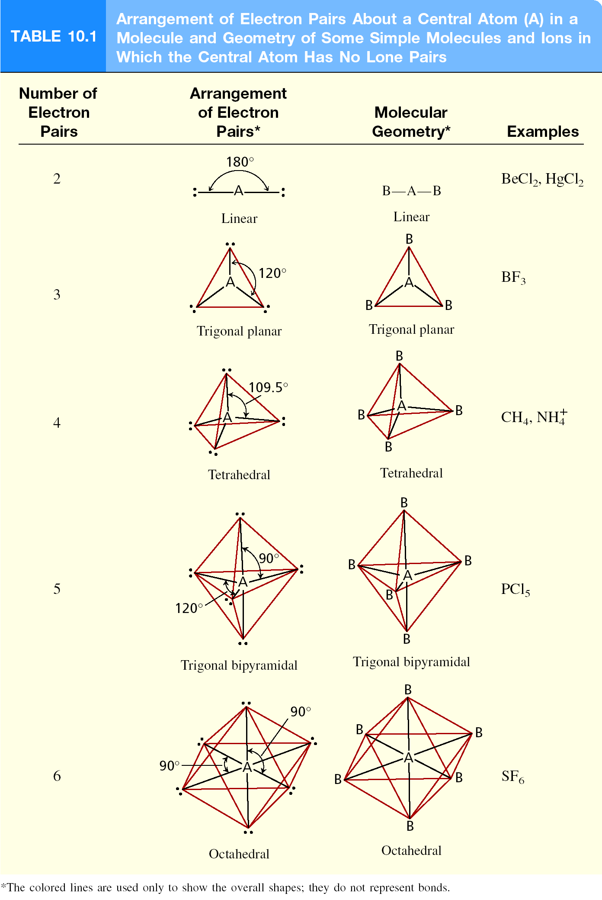
Number of electron pairs
Arrangement of
electron pairs
Molecular
Geometry
Examples

Slide 15
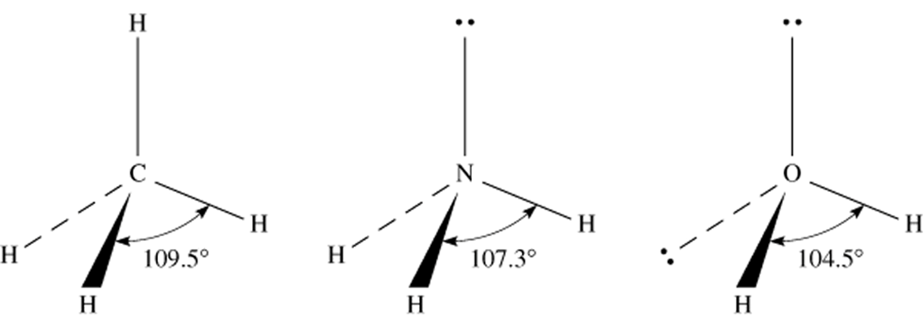
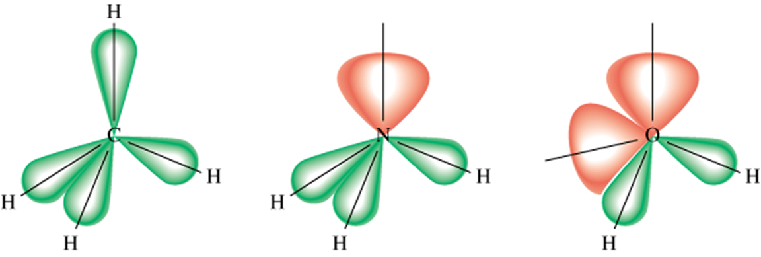
VSEPR model
Molecules in which the central atom has lone pairs
lone-pair vs. lone
pair repulsion
lone-pair vs. bonding
pair repulsion
bonding-pair vs. bonding
pair repulsion
>
>

Slide 16
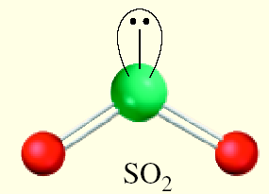
VSEPR model
Molecules in which the central atom has one or more lone pairs
Example:
Class
# of atoms bonded to central atom
# lone pairs on central atom
Arrangement of electron pairs
Molecular
Geometry
AB₃
3
0
trigonal planar
trigonal planar
AB₂E
2
1
trigonal planar
bent
Bent

Slide 17
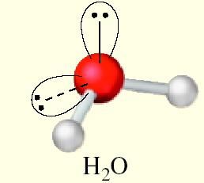
VSEPR model
# of atoms bonded to central atom
# lone pairs on central atom
Example:
Class
Arrangement of electron pairs
Molecular
Geometry
AB₄
4
0
tetrahedral
tetrahedral
AB₃E
3
1
tetrahedral
trigonal pyramidal
AB₂E₂
2
2
tetrahedral
bent
Bent

Slide 18
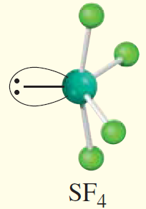
VSEPR model
# of atoms bonded to central atom
# lone pairs on central atom
Example:
Class
Arrangement of electron pairs
Molecular
Geometry
AB₅
5
0
trigonal bipyramidal
trigonal bipyramidal
AB₄E
4
1
trigonal bipyramidal
distorted tetrahedron
Distorted tetrahedron

Slide 19
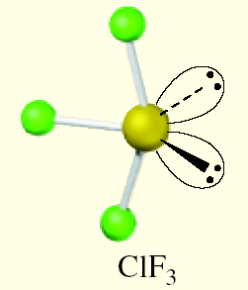
VSEPR model
# of atoms bonded to central atom
# lone pairs on central atom
Example:
Class
Arrangement of electron pairs
Molecular
Geometry
AB₅
5
0
trigonal bipyramidal
trigonal bipyramidal
AB₄E
4
1
trigonal bipyramidal
distorted tetrahedron
AB₃E₂
3
2
trigonal bipyramidal
T-shaped
T-shaped

Slide 20
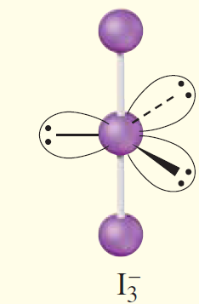
VSEPR model
# of atoms bonded to central atom
# lone pairs on central atom
Example:
Class
Arrangement of electron pairs
Molecular
Geometry
AB₅
5
0
trigonal bipyramidal
trigonal bipyramidal
AB₄E
4
1
trigonal bipyramidal
distorted tetrahedron
AB₃E₂
3
2
trigonal bipyramidal
T-shaped
AB₂E₃
2
3
trigonal bipyramidal
linear
Linear

Slide 21
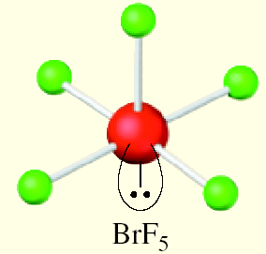
VSEPR model
# of atoms bonded to central atom
# lone pairs on central atom
Example:
Class
Arrangement of electron pairs
Molecular
Geometry
AB₆
6
0
Octahedral
Octahedral
AB₅E
5
1
Octahedral
square pyramidal
Square pyramidal

Slide 22
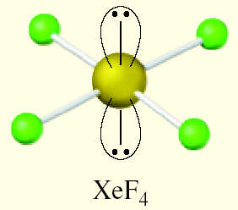
VSEPR model
# of atoms bonded to central atom
# lone pairs on central atom
Example:
Class
Arrangement of electron pairs
Molecular
Geometry
AB₆
6
0
Octahedral
Octahedral
AB₅E
5
1
Octahedral
square pyramidal
AB₄E₂
4
2
Octahedral
square planar
Square planar

Slide 23
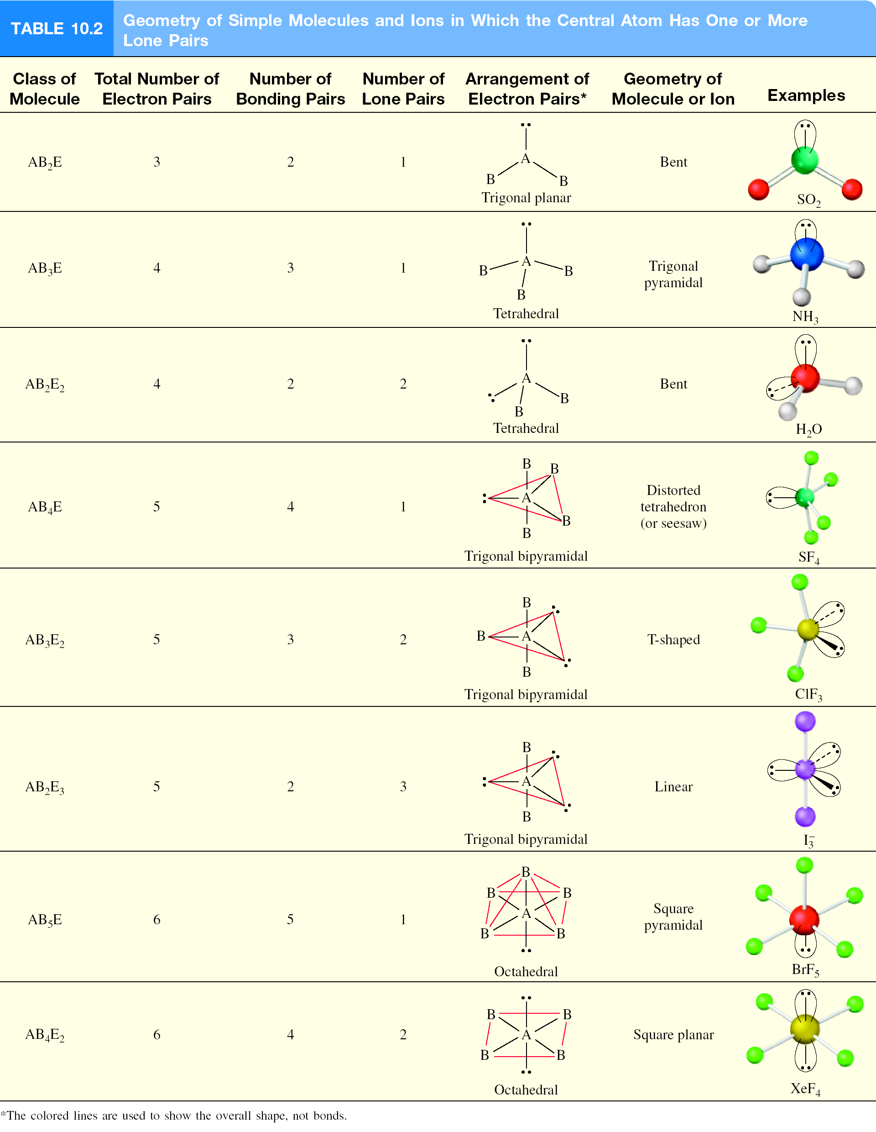
Class
Total number
of e⁻ pairs
Number of bonding pairs
Number of Lone pairs
Arrangement of
electron pairs
Molecular
Geometry
Examples

Slide 24
Predicting Molecular Geometry
General Steps:
Draw Lewis structure for molecule
Count number of lone pairs on the central atom and number of atoms bonded to the central atom
Use VSEPR to predict the geometry of the molecule
What are the molecular geometries of SO₂ and SF₄?
F
O
S
O
AB₂E
F
S
F
AB₄E
distorted
tetrahedron
bent
F

Slide 25
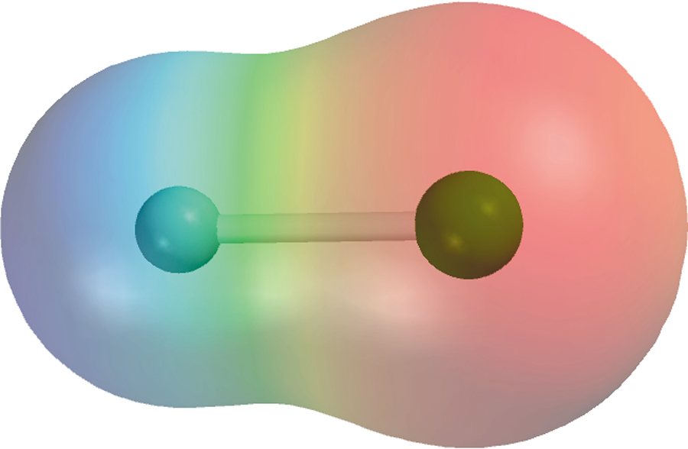
Dipole Moments and Polar Molecules
electron poor
region
electron rich
region
H
F
δ+
δ−
μ = Q x r
Q is the charge
r is the distance between charges
1 D = 3.36 x 10⁻³⁰ C m

Slide 26
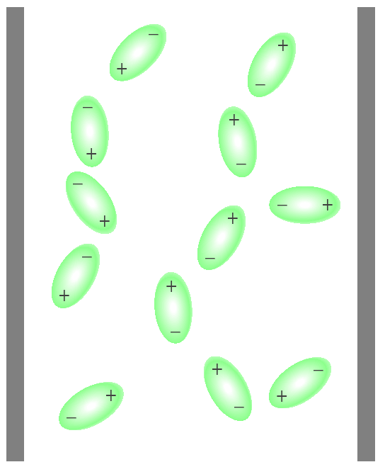
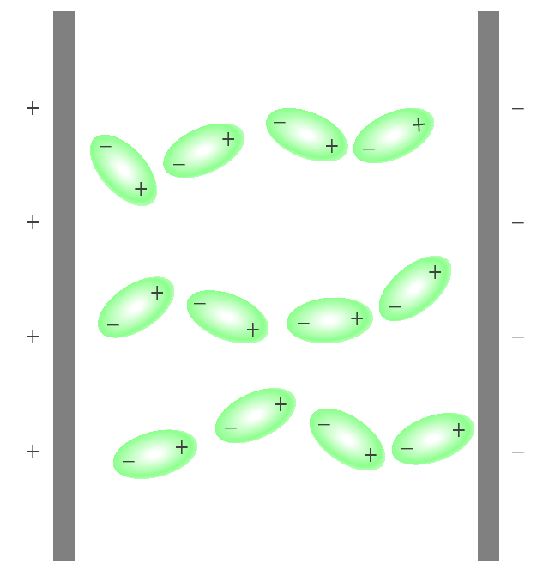
Behavior of Polar Molecules
field off
field on

Slide 27
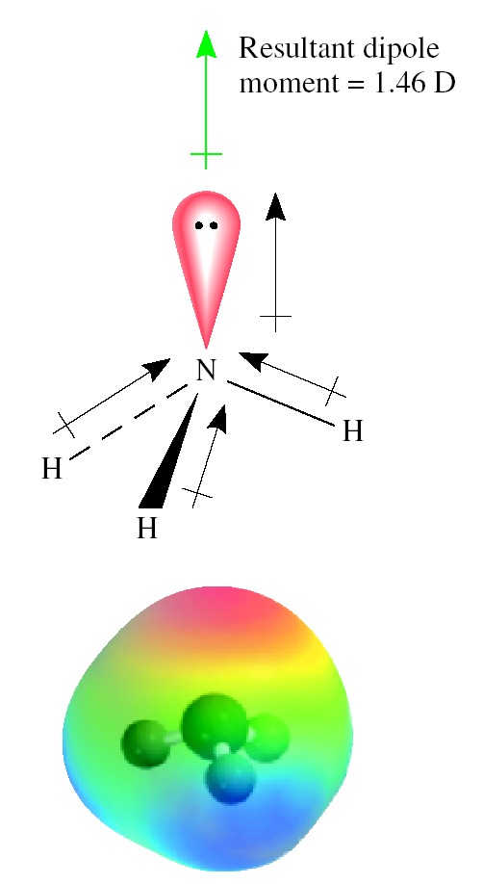
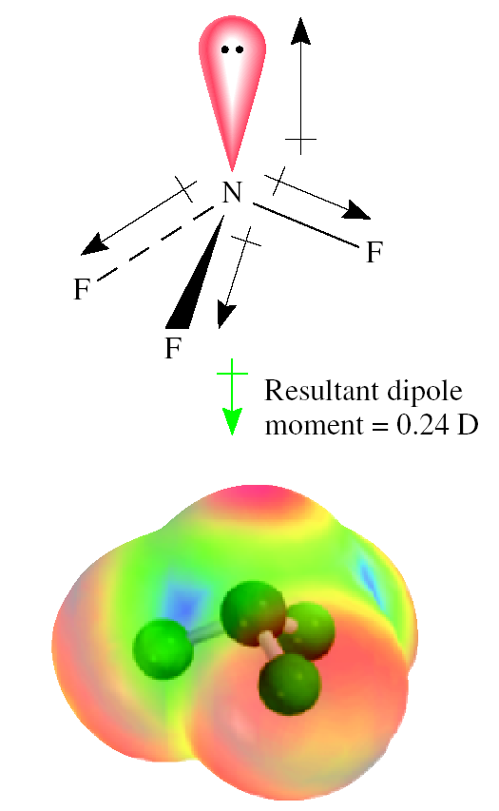
Bond moments and resultant dipole moments
Bond moments and resultant dipole moments in NH₃ and NF₃

Slide 28
Bond moments and resultant dipole moments
Which of the following molecules have a dipole moment?
H₂O, CO₂, SO₂, and CF₄
O
S
H
H
O
O
dipole moment
polar molecule
dipole moment
polar molecule
F
C
O
C
O
F
F
F
no dipole moment
nonpolar molecule
no dipole moment
nonpolar molecule

Slide 29
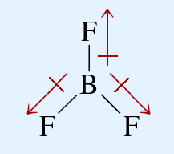
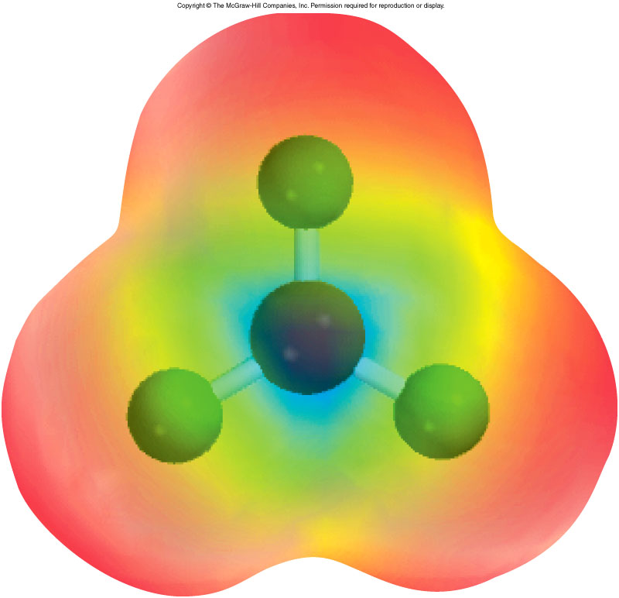
Bond moments and resultant dipole moments
Does BF₃ have a dipole moment?
no dipole moment
nonpolar molecule

Slide 30
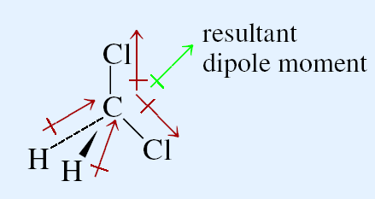
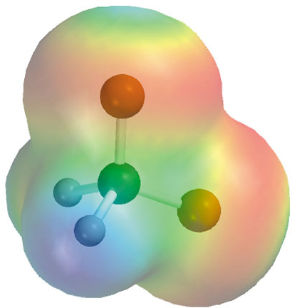
Bond moments and resultant dipole moments
Does CH₂Cl₂ have a dipole moment?

Slide 31
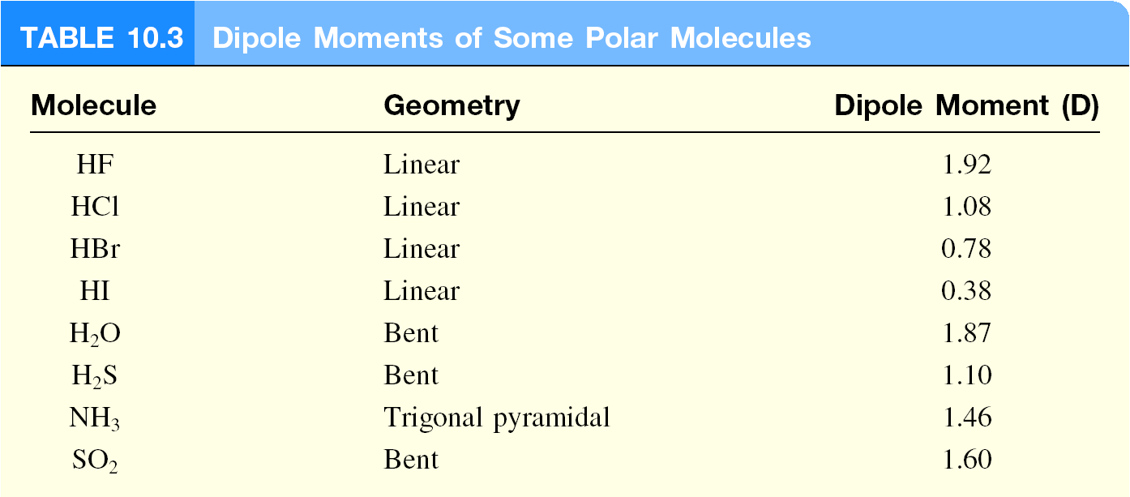
Dipole Moment of Polar Molecules
Dipole Moment of Polar Molecules

Slide 32
Lewis theory & Valence bond theory
How does Lewis theory explain the bonds in H₂ and F₂?
Sharing of two electrons between the two atoms.
Bond Enthalpy
Bond Length
Overlap of
H₂
436.4 kJ/mol
74 pm
2 1s
F₂
150.6 kJ/mol
142 pm
2 2p
Valence bond theory – bonds are formed by sharing of e⁻ from overlapping atomic orbitals.

Slide 33
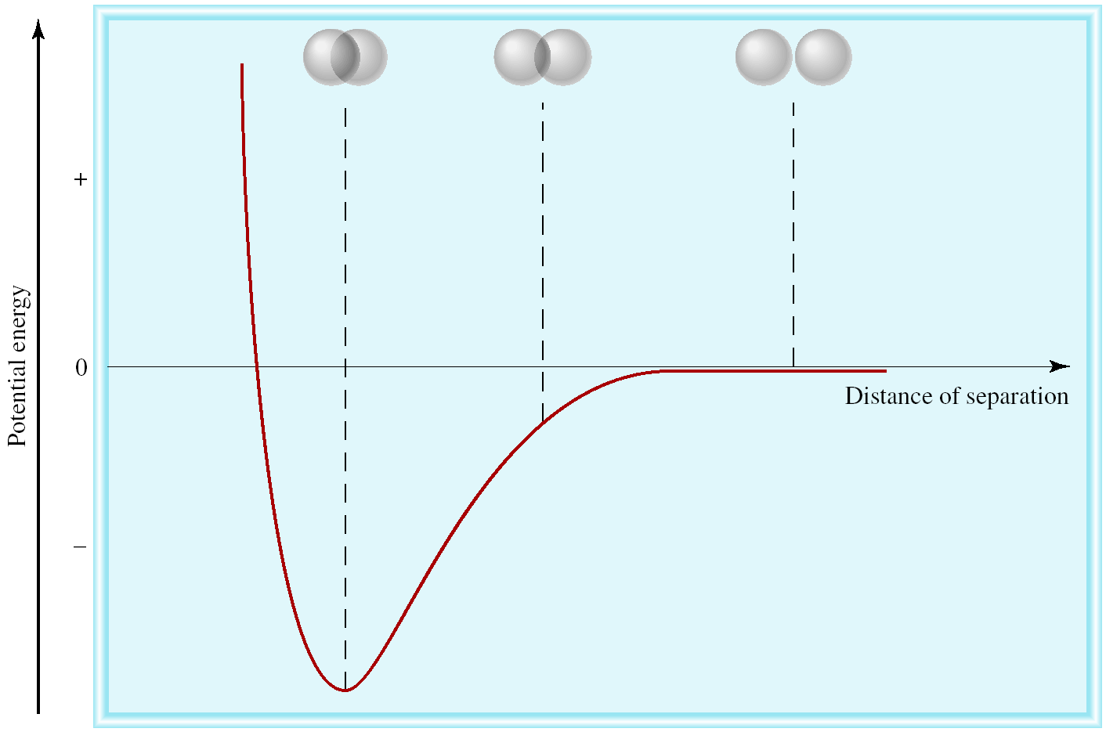
Potential Energy vs. Distance of Separation
Change in potential energy of two Hydrogen atoms as a function of their distance of separation

Slide 34
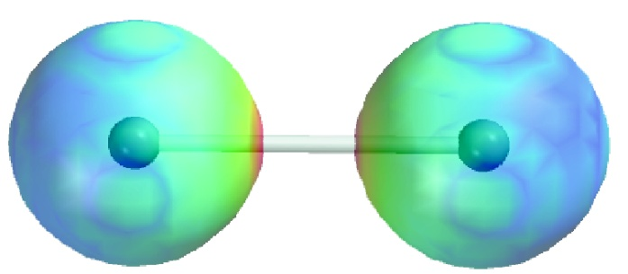
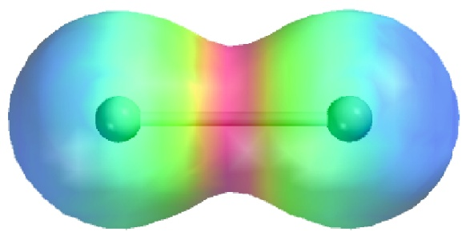
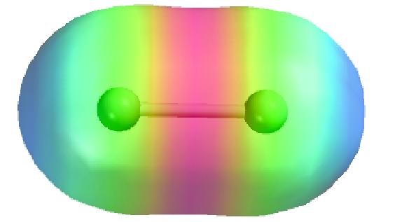
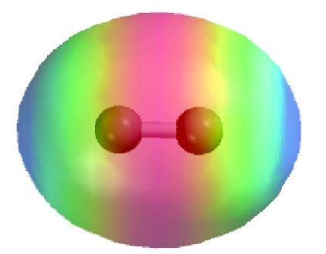
Change in Electron Density
Change in electron density as two hydrogen atoms approach each other

Slide 35
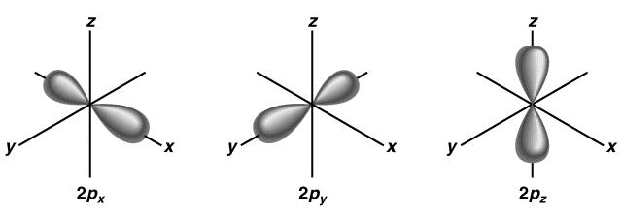
Valence Bond Theory and NH₃
N – 1s²2s²2p³
3 H – 1s¹
If use the 3 2p orbitals, predict 90º
Actual H-N-H bond angle is 107.3º

Slide 36
Hybridization
Hybridization – Mixing of two or more atomic orbitals to form a new set of hybrid orbitals
Mix at least 2 non-equivalent atomic orbitals (e.g. s and p). Hybrid orbitals have very different shape from original atomic orbitals
Number of hybrid orbitals are equal to number of pure atomic orbitals used in the hybridization process.
Covalent bonds are formed by:
Overlap of hybrid orbitals with atomic orbitals
Overlap of hybrid orbitals with other hybrid orbitals

Slide 37
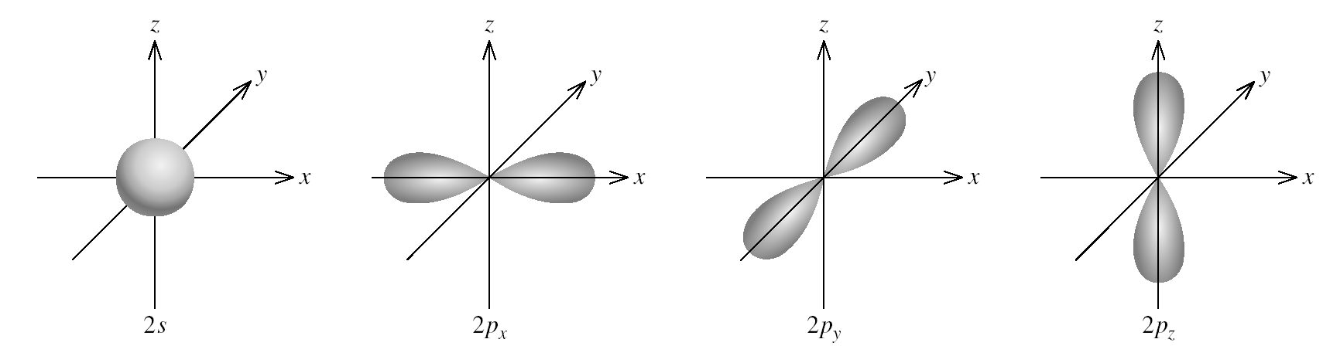
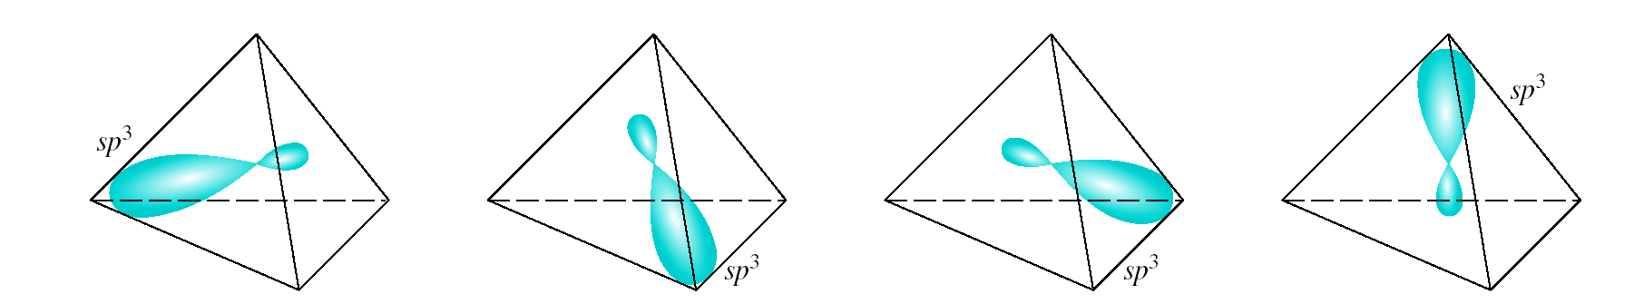
Formation of sp³ Hybrid Orbitals
Hybridization

Slide 38
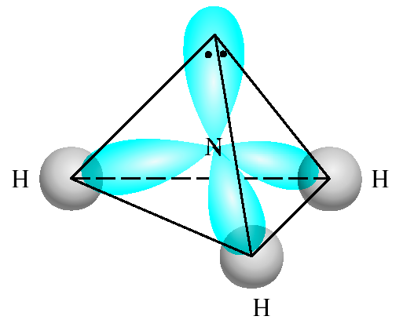
sp³-Hybridized N Atom in NH₃
N – 1s²2s²2p³
3 H – 1s¹
sp³
Predict correct
bond angle

Slide 39

Formation of Covalent Bonds in CH₄
C – 1s²2s²2p²
4 H – 1s¹
sp³

Slide 40



Formation of sp Hybrid Orbitals

Slide 41



Formation of sp² Hybrid Orbitals

Slide 42
Prediction of Hybridization
How do I predict the hybridization of the central atom?
Draw the Lewis structure of the molecule.
Count the number of lone pairs AND the number of atoms bonded to the central atom
# of Lone Pairs
+
# of Bonded Atoms
Hybridization
Examples
2
sp
BeCl₂
3
sp²
BF₃
4
sp³
CH₄, NH₃, H₂O
5
sp³d
PCl₅
6
sp³d²
SF₆

Slide 43

Hybridiza-
tion of central atom
Number of Hybrid orbitals
Shape of Hybrid orbitals
Pure AO of central atom
Examples

Slide 44



Hybridization in Molecules Containing Double and Triple Bonds
sp² Hybridization of Carbon

Slide 45

Hybridization
Unhybridized 2p_{z} orbital (gray), which is perpendicular to the plane of the hybrid (green) orbitals

Slide 46



Bonding in Ethylene, C₂H₄
Sigma bond (σ) – electron density between the 2 atoms
Pi bond (π) – electron density above and below plane of nuclei of the bonding atoms

Slide 47


Another View of π Bonding in Ethylene, C₂H₄

Slide 48



sp Hybridization of Carbon

Slide 49




Bonding in Acetylene, C₂H₂

Slide 50

Another View of the Bonding in Ethylene, C₂H₂

Slide 51


Bonding in Ethylene, CH₂O
Describe the bonding in CH₂O
H
C
O
H
C – 3 bonded atoms, 0 lone pairs
C – sp²

Slide 52
Sigma (σ) and Pi Bonds (π)
Single bond 1 sigma bond
Double bond 1 sigma bond and 1 pi bond
Triple bond 1 sigma bond and 2 pi bonds
How many σ and π bonds are in the acetic acid (vinegar) molecule CH₃COOH?
H
O
σ bonds = 6
+ 1 = 7
H
C
C
O
H
π bonds = 1
H

Slide 53
Thank You

